Slide 1
Unknown value of ARIMA model
Submitted by
Maharajan .C
Lakshmanan .A
M.C.A II Year

Slide 2
AGENDA
What is ARIMA?
ARIMA Introduction
ARIMA Definition
ARIMA models
Coding

Slide 3
Introduction
ARIMA, in short term as Auto-Regressive Integrated Moving Average, is a group of models used in R programming language to describe a given time series based on the previously predicted values and focus on the future values. The Time series analysis is used to find the behavior of data over a time period

Slide 4
ARIMA Definition
Autoregressive Integrated Moving-average
A “stochastic” modelling approach that can be used to calculate the probability of a future value lying between two specified limits

Slide 5
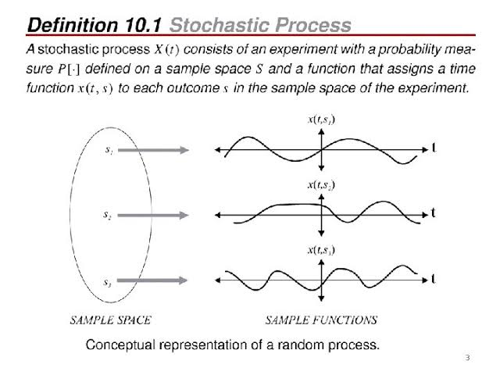
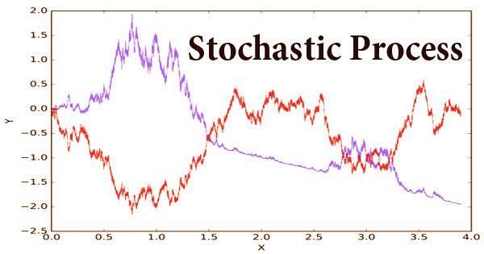
Stochastic Process

Slide 6
ARIMA Models
Two types
AR Model - Auto Regressive
MA Model – Moving average

Slide 7
AR & MA Models
Autoregressive AR Models:
Series current values depend on its own pervious values
AR(p) – Current values depend on its own p-previous values
P is the order of AR process
Moving average MA process:
The current deviation from mean depends on previous deviations
MA(q) – the current deviation from mean depends on q- previous deviations
Q is the order of MA Process
Autoregressive Moving average ARMA process

Slide 8
CODING
install.packages('forecast')
library(forecast)
weather_prod_input <- as.data.frame( read.csv("E:\\r\\weather.csv") )
weather_prod <- ts(weather_prod_input[,3])
plot(weather_prod, xlab = "Time (months)",
ylab = "weather between(1901-2017)")
plot(diff(weather_prod))
abline(a=0, b=0)
acf(diff(weather_prod), xaxp = c(0, 48, 4), lag.max=48, main="")
pacf(diff(weather_prod), xaxp = c(0, 48, 4), lag.max=48, main="")
arima_1 <- arima (weather_prod,
order=c(0,1,0),
seasonal = list(order=c(1,0,0),period=12))
arima_1
acf(arima_1$residuals, xaxp = c(0, 48, 4), lag.max=48, main="")
pacf(arima_1$residuals, xaxp = c(0, 48, 4), lag.max=48, main="")

Slide 9
arima_2 <- arima (weather_prod,
order=c(0,1,1),
seasonal = list(order=c(1,0,0),period=12))
arima_2
acf(arima_2$residuals, xaxp = c(0, 48, 4), lag.max=48, main="")
pacf(arima_2$residuals, xaxp = c(0, 48,4), lag.max=48, main="")
#Normality and Constant Variance
plot(arima_2$residuals, ylab = "Residuals")
abline(a=0, b=0)
hist(arima_2$residuals, xlab="Residuals", xlim=c(-20,20))
qqnorm(arima_2$residuals, main="")
qqline(arima_2$residuals)
#Forecasting
#predict the next 12 months
?predict()
arima_2.predict <- predict(arima_2,n.ahead=12)
?matrix()
matrix(c(arima_2.predict$pred-1.96*arima_2.predict$se,
arima_2.predict$pred,
arima_2.predict$pred+1.96*arima_2.predict$se), 12,1,
dimnames=list( c(117:128) ,c("Pred")) )

Slide 10
plot(weather_prod)
lines(arima_2.predict$pred)
lines(arima_2.predict$pred+1.96*arima_2.predict$se, col=4, lty=2)
lines(arima_2.predict$pred-1.96*arima_2.predict$se, col=4, lty=2)

Slide 11
T H A N K Y O U

